Slide 1
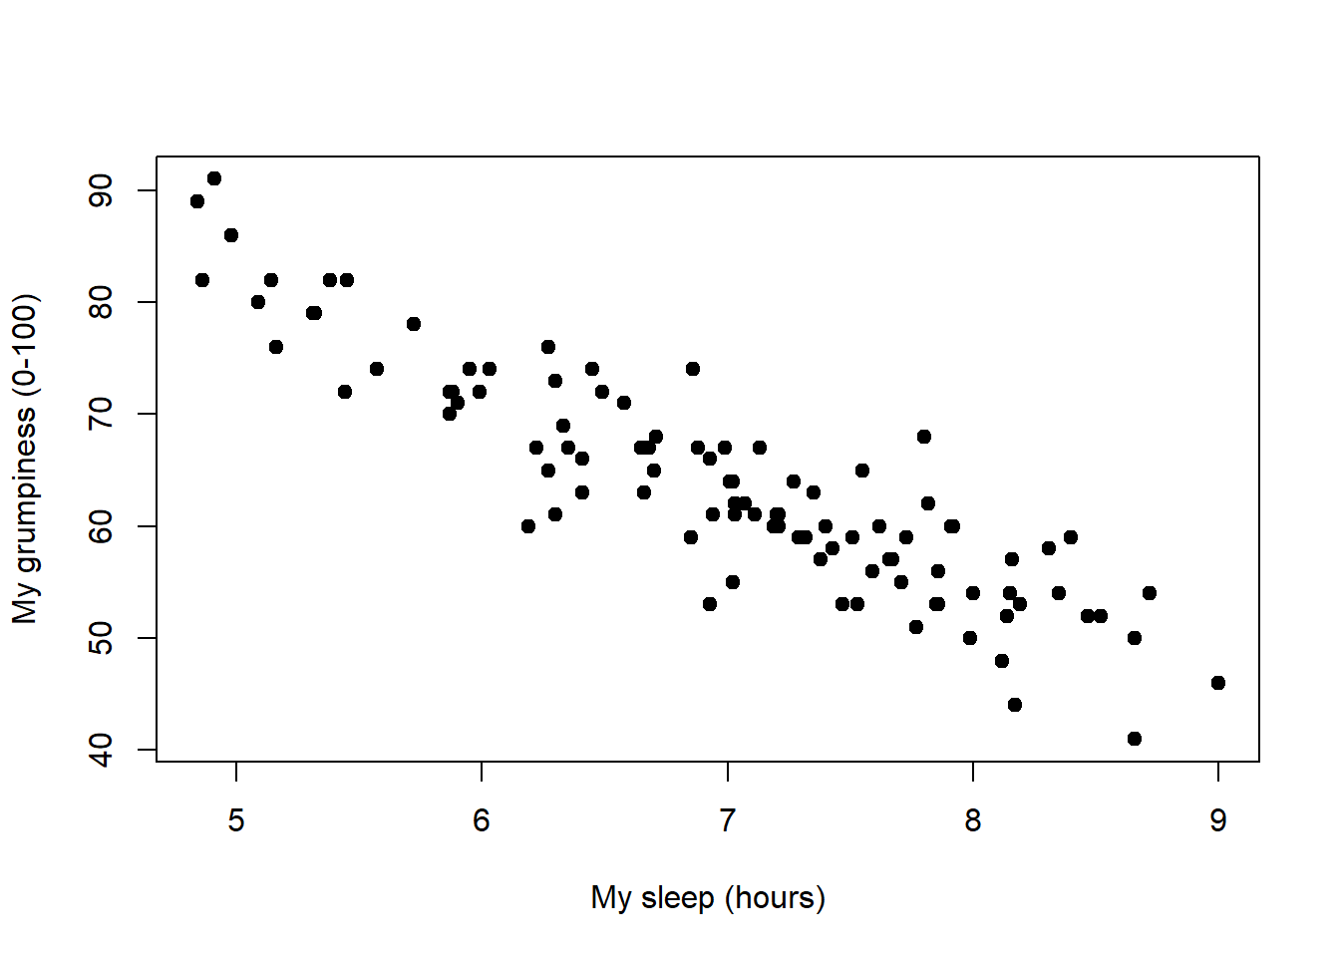
What Can Be Said?

Slide 2


Foundations of Linear Regression
Demystifying the Concept

Slide 3
Review
Descriptive Statistics
Measures of centrality
Measures of dispersion
Inferential Statistics
Hypothesis Testing
Confidence Intervals
Notes:
Descriptive statistics – describe basic features of the data (what the data is or shows)
Inferential Statistics – take data from samples and generalize about populations

Slide 4
What is Regression? (Regression Analysis)
Regression Analysis is a
Statistical Technique
for Investigating and Modeling the
Relationship Between Variables ⁽¹⁾

Slide 5
What is Regression? (Regression Analysis)
In simple terms…
Regression Analysis is a
Statistical Technique
Identify any Relationship between variables
and
Predict the Output of a Process
Notes:
Linear regression is used when we want to predict the value of a variable based on the value of another variable.
Two main objectives:
-Establish if there is a relationship b/w two variables (more importantly if its statistically significant). Ex. Income vs. spending, height vs. weight
-Predict new observations based on any deduced relationships. (helps us answer questions like, “What will be the expected sales over the next quarter?”)

Slide 6


How do we MODEL THE RELATIONSHIP BETWEEN the VARIABLES?
⁽³⁾
Notes:
When we think about “model relationships” we probably think of something along the lines of…. Derek and Hanzel

Slide 7

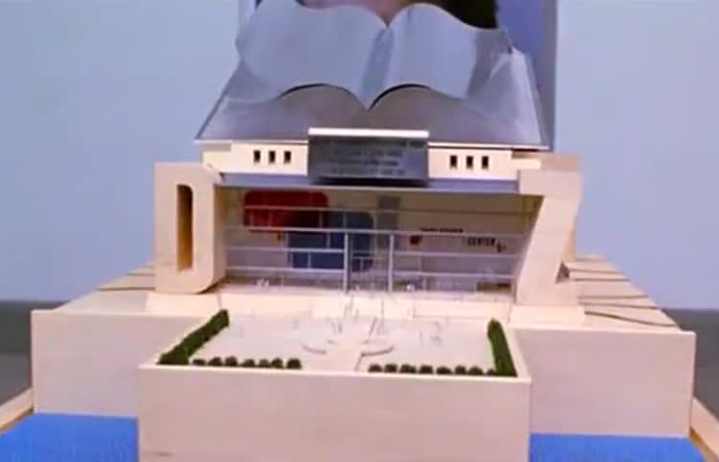
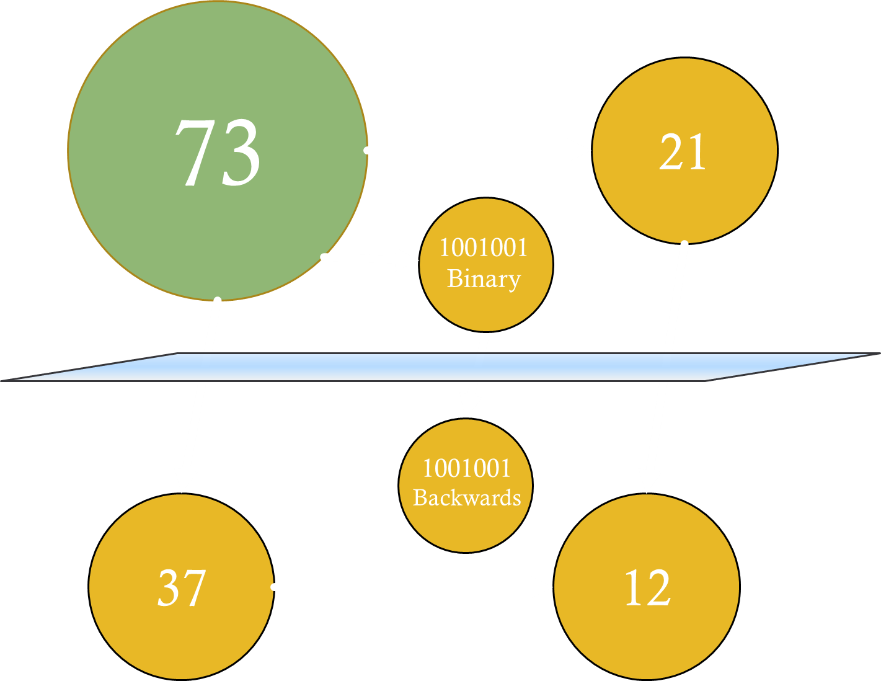

⁽³⁾
How do we MODEL THE RELATIONSHIP BETWEEN the VARIABLES?
⁽⁴⁾
Notes:
Options for modeling are conceptual model (73 is the best number), physical model (Derek Zoolander’s center for kids who can’t read good and want to learn how to do other stuff good too), or a mathematical model (the signal mitigation model of a passive bi-static Synthetic Aperture Radar through nominal atmospheric conditions).

Slide 8
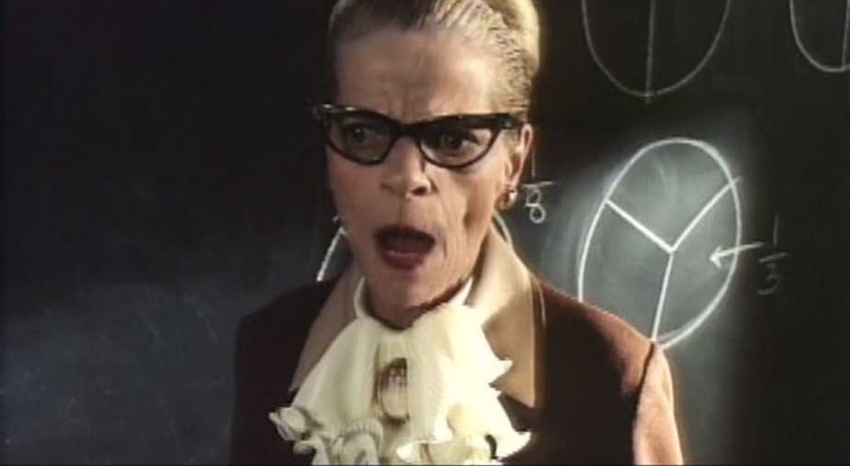
How do we MODEL THE RELATIONSHIP BETWEEN the VARIABLES?
Mrs. Edelson’s 7th Grade class…
⁽⁵⁾
y = mx + b

Slide 9
How do we MODEL THE RELATIONSHIP BETWEEN the VARIABLES?
Mrs. Edelson’s 7th Grade class…
⁽⁵⁾
y = mx + b

Slide 10
y = mx + b
Where y is the measure of interest
m is the unit change in y per unit change of x (or the slope; rise over run)
and b is the value of y when x = 0
(or y-intercept)

Slide 11
Let’s look at the linear relationship
( y = mx + b )
of something we are all familiar with:
Bank Account Balance and
Price of Gas/Gallon
Intercept (b) = $250
Slope (m) = $-2.65/gal

Slide 12
Now, let’s look at the linear relationship of:
Vacation Costs and
# of Nights at A Location
Intercept (b) = $4895
Slope (m) = $251/night
Notes:
While we like to model things as a “pure linear relationship” we find that things don’t exactly follow the model (all models are wrong, some are useful). For the balance of our bank account vs amount of gas we buy, even if we only purchase gas, the price of gas per gallon is volatile and changes regularly. The same as the vacation cost vs number of nights at the location. Some costs vary as the time we spend in the location increases; i.e. rental car prices change the longer we rent, food costs are really estimates only and vary depending upon the activities we choose to participate in. So how can we model things as linear when they don’t exactly match the linear model? Lets look at a specific dataset…

Slide 13
Size of a Home and its corresponding Sale Price
 | 1 | 2 | 3 | 4 | 5 | 6 | 7 | 8 | 9 | 10 | 11 | 12
Size | 1501 | 1500 | 1175 | 1232 | 1121 | 988 | 1240 | 998 | 1225 | 1552 | 975 | 1121
Price | 28.9 | 29.5 | 27.9 | 25.9 | 29.9 | 29.9 | 30.9 | 25.9 | 35.9 | 31.5 | 31 | 30.9
 | 13 | 14 | 15 | 16 | 17 | 18 | 19 | 20 | 21 | 22 | 23 | 24
Size | 1020 | 1664 | 1488 | 1376 | 1500 | 1256 | 1690 | 1820 | 1652 | 1777 | 1504 | 1831
Price | 30 | 36.9 | 41.9 | 40.5 | 43.9 | 37.5 | 37.9 | 44.5 | 37.9 | 38.9 | 36.9 | 45.8
Sale Price ($1000)
Home Size (ft² x 1000)
Notes:
We have a set of 24 points of data specifying

Slide 14
Size of a Home and its corresponding Sale Price
m b
m₁ b₁
m₂ b₂
m₃ b₃
⁞ ⁞
Sale Price ($1000)
m∞ b∞
Home Size (ft² x 1000)

Slide 15
Size of a Home and its corresponding Sale Price
m b
m₁ b₁
m₂ b₂
m₃ b₃
⁞ ⁞
Sale Price ($1000)
m∞ b∞
Which Line is BEST?
Home Size (ft² x 1000)

Slide 16
Let’s minimize the Total Distance from each Data Point and any “described” Line.
(for a particular m & b pairing)

Slide 17
Sale Price ($1000)
m = $17.96/ft²
b = $13,596
Home Size (ft² x 1000)

Slide 18
Sale Price ($1000)
m = $17.96/ft²
b = $13,596
Home Size (ft² x 1000)

Slide 19
ε₂₄
ε₄
ε₈
ε₇
ε₁₀
ε₁
ε₃
ε₆
ε₉
ε₅
x₁= 1,501
ε₂
y₁= $28,900
(ŷ₁ = mx₁ + b)
ŷ₁= $40,554
m = $17.96/ft²
b = $13,596
ε₁= -$11,654

Slide 20

Then for any m and b pair…
m₁ b₁
x₁ y₁ ŷ₁
x₂ y₂ ŷ₂
x₃ y₃ ŷ₃
⁞ ⁞ ⁞
x_{n} y_{n} ŷ_{n}
( )²
( )²
( )²
( )²
–
–
–
–
+
$$\sqrt{\frac{\sum_{i=1}^{n}{{(y_{i}−\hat{y_{i}})}^{2}}}{n−2}}$$
√
SUM
Standard Error
÷
=
=
n – 2

Slide 21


Then for any m and b pair…
m₁ b₁
$$Std Dev= \sqrt{\frac{\sum_{i=1}^{n}{{(x_{i}− \overline{x})}^{2}}}{n−1}}$$
Does the F_{x} for Std Error remind us of anything?
x₁ y₁ ŷ₁
x₂ y₂ ŷ₂
x₃ y₃ ŷ₃
⁞ ⁞ ⁞
x_{n} y_{n} ŷ_{n}
( )²
( )²
( )²
( )²
–
–
–
–
For Std Error…
Lower
is
Better
+
$$\sqrt{\frac{\sum_{i=1}^{n}{{(y_{i}−\hat{y_{i}})}^{2}}}{n−2}}$$
Standard Error
=

Slide 22

$$\sqrt{\frac{\sum_{i=1}^{n}{{(y_{i}−\hat{y_{i}})}^{2}}}{n−2}}$$
Then for any m and b pair…
Standard Error
=
m₁ b₁
$$Std Dev= \sqrt{\frac{\sum_{i=1}^{n}{{(x_{i}− \overline{x})}^{2}}}{n−1}}$$
x₁ y₁ ŷ₁
x₂ y₂ ŷ₂
x₃ y₃ ŷ₃
⁞ ⁞ ⁞
x_{n} y_{n} ŷ_{n}
( )²
( )²
( )²
( )²
–
–
–
–
+
$$\sqrt{\frac{\sum_{i=1}^{n}{{(y_{i}−\hat{y_{i}})}^{2}}}{n−2}}$$
Standard Error
=

Slide 23
$$\sqrt{\frac{\sum_{i=1}^{n}{{(y_{i}−\hat{y_{i}})}^{2}}}{n−2}}$$
Then for any m and b pair…
Standard Error
=
m₁ b₁
m₂ b₂
m₃ b₃
…
…
…
m_{m} b_{m}
x₁ y₁ ŷ₁
x₂ y₂ ŷ₂
x₃ y₃ ŷ₃
⁞ ⁞ ⁞
x_{n} y_{n} ŷ_{n}
x₁ y₁ ŷ₁
x₂ y₂ ŷ₂
x₃ y₃ ŷ₃
⁞ ⁞ ⁞
x_{n} y_{n} ŷ_{n}
x₁ y₁ ŷ₁
x₂ y₂ ŷ₂
x₃ y₃ ŷ₃
⁞ ⁞ ⁞
x_{n} y_{n} ŷ_{n}
x₁ y₁ ŷ₁
x₂ y₂ ŷ₂
x₃ y₃ ŷ₃
⁞ ⁞ ⁞
x_{n} y_{n} ŷ_{m}
( )²
( )²
( )²
( )²
( )²
( )²
( )²
( )²
( )²
( )²
( )²
( )²
–
–
–
–
( )²
( )²
( )²
( )²
SE₁ < = > SE₂ < = > SE₃ < = > … SE_{m}
=
=
=
=
SE₁
SE₂
SE₃
SE_{m}

Slide 24
$$\sqrt{\frac{\sum_{i=1}^{n}{{(y_{i}−\hat{y_{i}})}^{2}}}{n−2}}$$
Then for any m and b pair…
Standard Error
=
SE₁ < = > SE₂ < = > SE₃ < = > … SE_{m}
SE₅
SE₅ < SE₁ < SE₃ < SE₆ < SE₂ < … SE_{m}
For our 24 data points, the 5th m & b pair minimizes the Std Error.
m = $15.43/ft²
b = $13,259

Slide 25
Size of a Home and its corresponding Sale Price
m = $15.43/ft²
b = $13,259

Slide 26
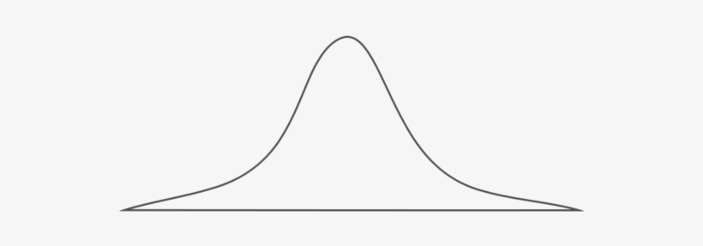
Size of a Home and its corresponding Sale Price
N(0,σ² =9)
m = $15.433
b = $13,259
Notes:
This slide is for an advanced classes regarding linear regression
The true regression model μ_{y|x} = β₀ + β₁x is a line of mean values; that is, the height of the regression line at any value of x is just the expected value of y for that x. The slope β₁ , can be interpreted as the change in the mean of y for a unit change in x. Furthermore, the variability of y at a particular value of x is determined by the variance of the error component of the model, σ². This implies that there is a distribution of y values at each x and that the variance of this distribution is the same at each x.

Slide 27
Then for any set of paired data points (x_{i}, y_{i})…
mx_{i}
b
y_{i} = mx_{i} + b
y_{i} = b + mx_{i}
Let: b = β₀ and m = β₁
y_{i} = β₀ + β₁x_{i}
Notes:
Slide begins advance Linear Regression Intro

Slide 28
Then for any set of paired data points (x_{i}, y_{i})…
y_{i} = β₀ + β₁x_{i} + ε_{i}
y_{i} = b + mx_{i}
Let: b = β₀ and m = β₁
y_{i} = β₀ + β₁x_{i}
+ ε_{i}
Unknown Constants
Random Error Component
Notes:
This slide is for an advanced classes regarding linear regression :Duplicate of slide 25 and is meant to be a build for the method of minimization of sum of squares. (which is yet to be built)

Slide 29


Sum of Squares
ŷ_{i} = β₀ + β₁x_{i}
$\frac{δS}{δ\hat{β_{0}}}=$0
$\frac{δS}{δ\hat{β_{1}}}=$0

Slide 30
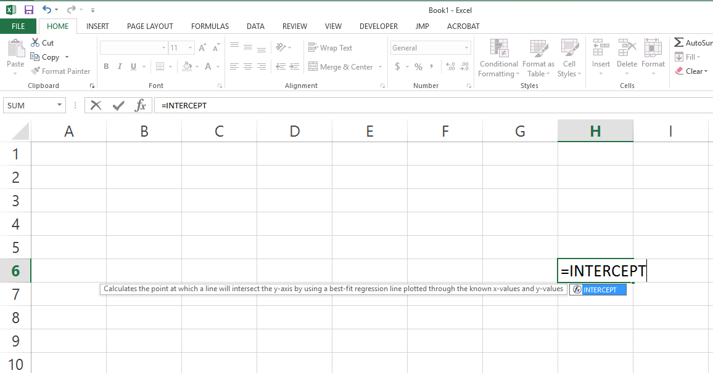
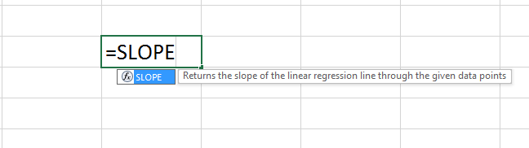
Simple Calculus (w/complicated Algebra) to minimize sum of square estimates of β₀ and β₁.

Slide 31
Simple Calculus (w/complicated Algebra) to find the best fit estimates of Slope and Intercept.

Slide 32
Application of Standard Error, Correlation, R² and p-value across a data set

Slide 33
Implications of Standard Error (Think about Std Dev)
Standard Error gives a way to describe the “Variance” between our
Model and the Actual Data.
In common terms, Standard Error
describes the “Scattericity” of the data.
Notes:
Standard error – average distance the observed values fall from the regression line.
Helps us talk about how the world doesn’t follow a perfect linear line

Slide 34
Two Distinct Data Sets
$70k
$60k
$50k
m = $2k/yr
b = $12k
SE = $2k
$40k
Salary
$30k
m = $2k/yr
b = $12k
SE = $8k
$20k
$10k
$5k
0
2
4
6
8
10
12
14
16
18
20
22
24
26
28
Company 1
Years of Experience
Company 2

Slide 35
Two Distinct Data Sets
$70k
What would be the expected
salary for someone with
17 years experience?
$60k
$50k
m = $2k/yr
b = $12k
SE = $2k
$40k
Salary
$30k
m = $2k/yr
b = $12k
SE = $8k
$20k
$10k
$5k
0
2
4
6
8
10
12
14
16
18
20
22
24
26
28
Years of Experience

Slide 36
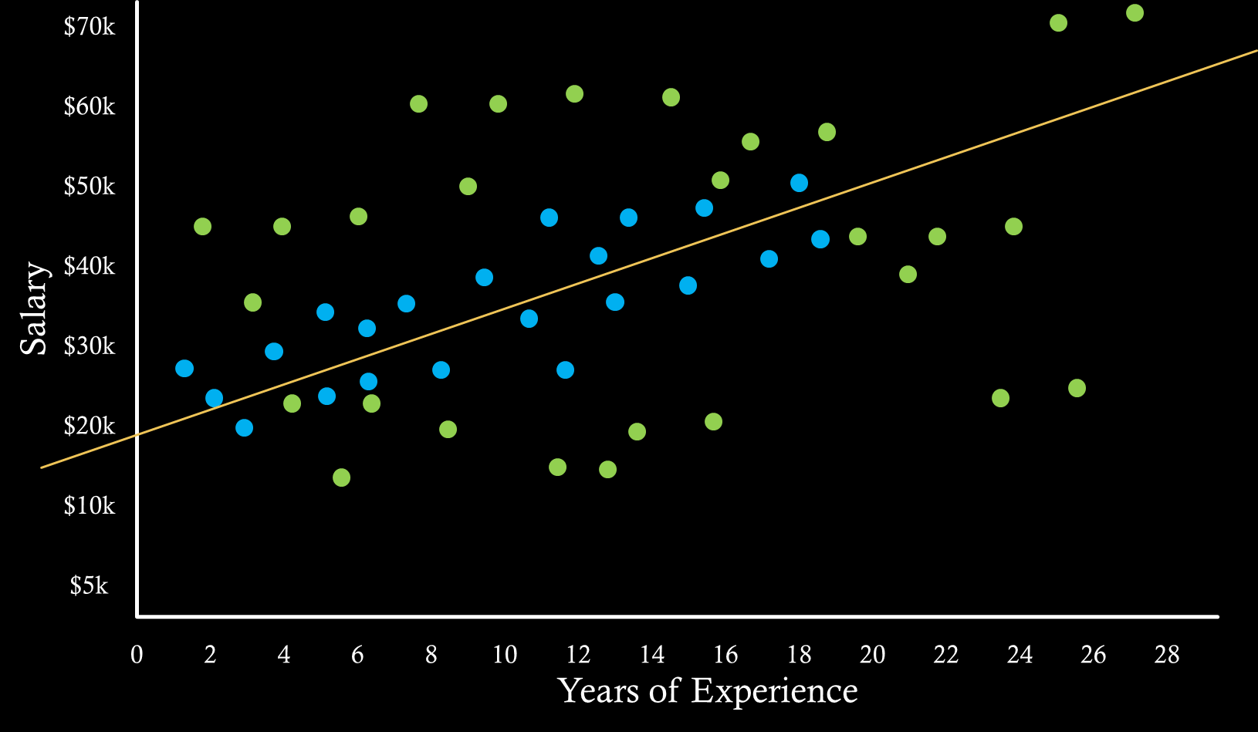
Two Distinct Data Sets
What would be the expected salary for someone with
17 years experience?
ŷ = ($2k/yr)x + $12k
when x = 17
m = $2k/yr
b = $12k
SE = $2k
ŷ = ($2k/yr)17yr + $12k = $46k
SE = $2k
m = $2k/yr
b = $12k
SE = $8k
ŷ = ($2k/yr)17yr + $12k = $46k
SE = $8k

Slide 37
Two Distinct Data Sets
What would be the expected salary for someone with
17 years experience?
ŷ = ($2k/yr)x + $12k
when x = 17
ŷ = ($2k/yr)17yr + $12k = $46k
SE = $2k
ŷ = ($2k/yr)17yr + $12k = $46k
SE = $8k

Slide 38
Two Distinct Data Sets
How often will we be
within $4K of our estimate $46K?
ŷ = ($2k/yr)17yr + $12k = $46k
± 2 Std Error
≈ 95.5%
SE = $2k
ŷ = ($2k/yr)17yr + $12k = $46k
± 0.5 Std Error
≈ 38.3%
SE = $8k

Slide 39
Correlation (Pearson’s Correlation Coefficient)
Measures the
Strength and the Direction
of a relationship between variables.
-1
0
1
Stronger
Stronger
Weaker
Notes:
Correlation coefficient:
-measurement of the strength and direction of the relationship
-ranges from -1 to 1 and denoted as r
-1 denotes a perfect positive correlation, -1 denotes a perfect negative correlation, 0 denotes no correlation

Slide 40
Two Distinct Data Sets
Correlation
$70k
$60k
m = $2k/yr
b = $12k
SE = $2k
$50k
$40k
Corr = 0.76
Salary
$30k
m = $2k/yr
b = $12k
SE = $8k
$20k
$10k
Corr = 0.38
$5k
0
2
4
6
8
10
12
14
16
18
20
22
24
26
28
Years of Experience

Slide 41
R² (R-Squared) (Coefficient of Determination)
How much of the
Variation in the Response (y)
is explained by the
Variation in the Predictor(x).
0 ≤ R² ≤ 1
Notes:
We want to know how well it fits. Essentially R-squared is the ratio of explained variance to unexplained variance.
R² = 0 Nothing is explained
R² = 1 Everything is explained
Biased estimator – a parameter estimate that tends to underestimate or overestimate the expected value
R-squared is generally not a good indicator of fit but for our simple, this will be a good initial value to gauge our model.

Slide 42
Two Distinct Data Sets
R²
$70k
$60k
m = $2k/yr
b = $12k
SE = $2k
Corr = 0.76
$50k
$40k
Salary
R² = 0.578
$30k
m = $2k/yr
b = $12k
SE = $8k
Corr = 0.38
$20k
$10k
R² = 0.144
$5k
0
2
4
6
8
10
12
14
16
18
20
22
24
26
28
Years of Experience

Slide 43
P-Value (Hypothesis Test)
The p-value tells us how likely it is the x (predictor)
has nothing to do with the y (response).
We want p < 0.05
0 ≤ p ≤ 1
Notes:
The p-value helps determines whether the relationship in the sample also exists in the larger population.
It tests the null hypothesis that “no correlation with the dependent variable exists”.

Slide 44
Two Distinct Data Sets
p-value
$70k
$60k
m = $2k/yr
b = $12k
SE = $2k
Corr = 0.76
$50k
$40k
Salary
R² = 0.578
$30k
p = 0.000148
m = $2k/yr
b = $12k
SE = $8k
Corr = 0.38
$20k
$10k
R² = 0.144
$5k
p = 0.000317
0
2
4
6
8
10
12
14
16
18
20
22
24
26
28
Years of Experience

Slide 45
Assumptions of Linear Regression (LINE)
Mean of the response (y) at each value of the predictor (x_{i})is a Linear Function.
The Errors (ε_{i}) at each value of the predictor (x_{i}) are Independent.
The Errors (ε_{i}) at each value of the predictor (x_{i}) are
Normally Distributed.
The Errors (ε_{i}) at each value of the predictor (x_{i}) have
Equal Variance.

Slide 46
Review
Regression Equation: y = m * x + b
Standard Error: Average Distance from Line
Correlation: Strength and Direction (-1 ≤ r ≤ 1)
R-Squared: How much explained? (0 ≤ r ≤ 1)
P-value: Is there a significant relationship? (p ≤ 0.05?)

Slide 47
Sources
1. Montgomery, D.C. and Peck and E.A., Vining, G.G. [2006], Introduction to Linear Regression Analysis, Fourth Edition, Wiley, New York , NY
2. Costa, Rebecca D., [2017], On the Verge, Rosetta Books, New York, NY
3. Stiller, Ben, and Hamburg, John and Sather, John, [2001], Zoolander, Paramount Pictures, Hollywood, CA
4. Lorre, Chuck and Prady, John, [2007], The Big Bang Theory, CBS Studios, New York, NY
5. Cunningham, Lowell and Solomon, Ed, [1997], Men In Black, Columbia Pictures, Culver City, CA

Slide 48
Regression Data Collection
A Retrospective Study Based on Historical Data
An Observational Study
A Designed Experiment

Slide 49
73
21
1001001
Binary
1001001
Backwards
37
12

Slide 50
Size of a Home and its corresponding Sale Price

